Slide 1
Software Design Basics
Notes:
The scheduling slides are from UNC scheduling. The software engineering slides are from UNC software testing, and chater 5 of Conrad-Dean

Slide 2
Overview
Concurrency
How do we make things happen at the right times?
Software Engineering for Embedded Systems
How do we develop working code quickly?

Slide 3
Concurrency

Slide 4
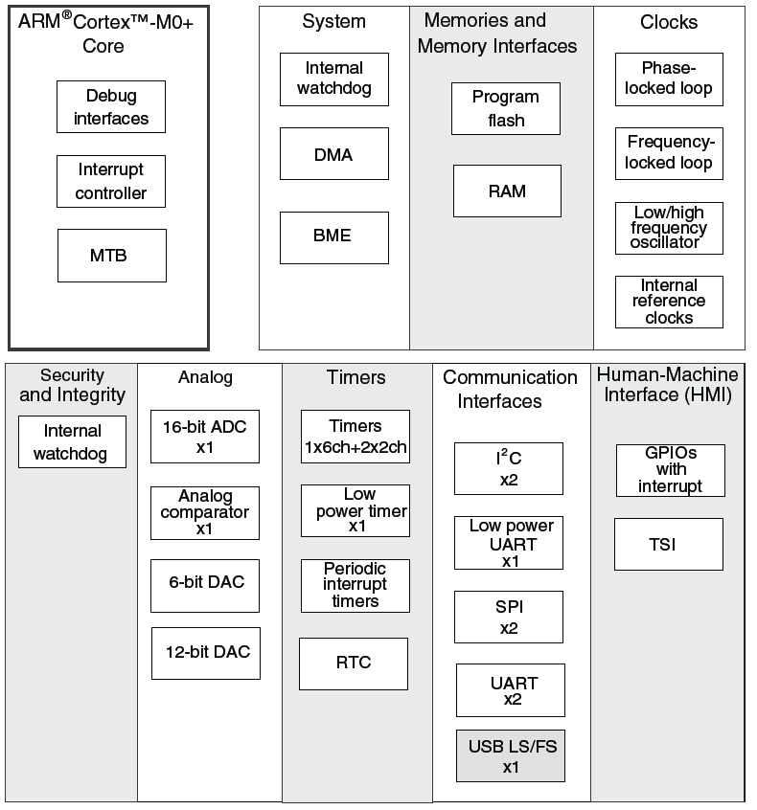
MCU Hardware & Software for Concurrency
CPU executes instructions from one or more thread of execution
Specialized hardware peripherals add dedicated concurrent processing
DMA - transferring data between memory and peripherals
Watchdog timer
Analog interfacing
Timers
Communications with other devices
Detecting external signal events
Peripherals use interrupts to notify CPU of events

Slide 5
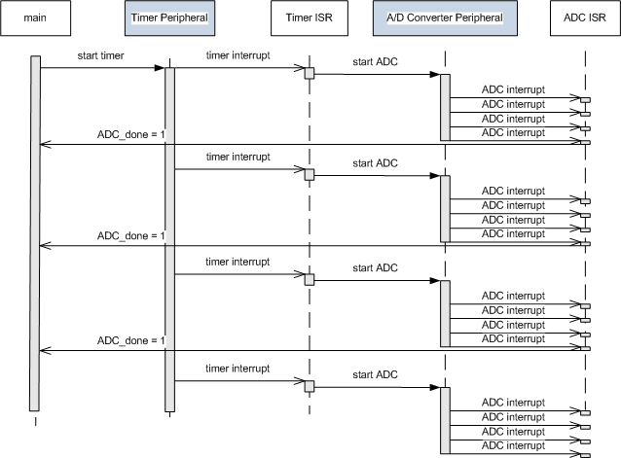
Concurrent Hardware & Software Operation
Software
Hardware
Software
Hardware
Software
Time
Embedded systems rely on both MCU hardware peripherals and software to get everything done on time

Slide 6
CPU Scheduling
MCU’s Interrupt system provides a basic scheduling approach for CPU
“Run this subroutine every time this hardware event occurs”
Is adequate for simple systems
More complex systems need to support multiple concurrent independent threads of execution
Use task scheduler to share CPU
Different approaches to task scheduling
How do we make the processor responsive? (How do we make it do the right things at the right times?)
If we have more software threads than hardware threads, we need to share the processor.

Slide 7
Definitions
T_{Release}
Other
processing
T_{task}
Scheduler
Task or ISR Code
Latency
Response
Time
Time
T_{Release}(i) = Time at which task (or interrupt) i requests service/is released/is ready to run
T_{Latency} (i) = Delay between release and start of service for task i
T_{Response}(i) = Delay between request for service and completion of service for task i
T_{Task}(i) = Time needed to perform computations for task i
T_{ISR}(i) = Time needed to perform interrupt service routine i

Slide 8
Scheduling Approaches
Rely on MCU’s hardware interrupt system to run right code
Event-triggered scheduling with interrupts
Works well for many simple systems
Use software to schedule CPU’s time
Static cyclic executive
Dynamic priority
Without task-level preemption
With task-level preemption

Slide 9
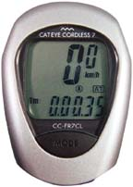
Event-Triggered Scheduling using Interrupts
Basic architecture, useful for simple low-power devices
Very little code or time overhead
Leverages built-in task dispatching of interrupt system
Can trigger ISRs with input changes, timer expiration, UART data reception, analog input level crossing comparator threshold
Function types
Main function configures system and then goes to sleep
If interrupted, it goes right back to sleep
Only interrupts are used for normal program operation
Example: bike computer
Int1: wheel rotation
Int2: mode key
Int3: clock
Output: Liquid Crystal Display
Notes:
Slides 10 and 11 of UNC scheduling

Slide 10
Bike Computer Functions
Reset
ISR 1: Wheel rotation
ISR 2: Mode Key
ISR 3:
Time of Day Timer
Configure timer,
inputs and
outputs
cur_time = 0;
rotations = 0;
tenth_miles = 0;
while (1) {
sleep;
}
rotations++;
if (rotations> R_PER_MILE/10) {
tenth_miles++;
rotations = 0;
}
speed =
circumference/
(cur_time – prev_time);
compute avg_speed;
prev_time = cur_time;
return from interrupt
mode++;
mode = mode %
NUM_MODES;
return from interrupt;
cur_time ++;
lcd_refresh--;
if (lcd_refresh==0) {
convert tenth_miles
and display
convert speed
and display
if (mode == 0)
convert cur_time
and display
else
convert avg_speed
and display
lcd_refresh =
LCD_REF_PERIOD
}
Displays 3 items; distance, speed, time or average speed (depending on mode selection)

Slide 11
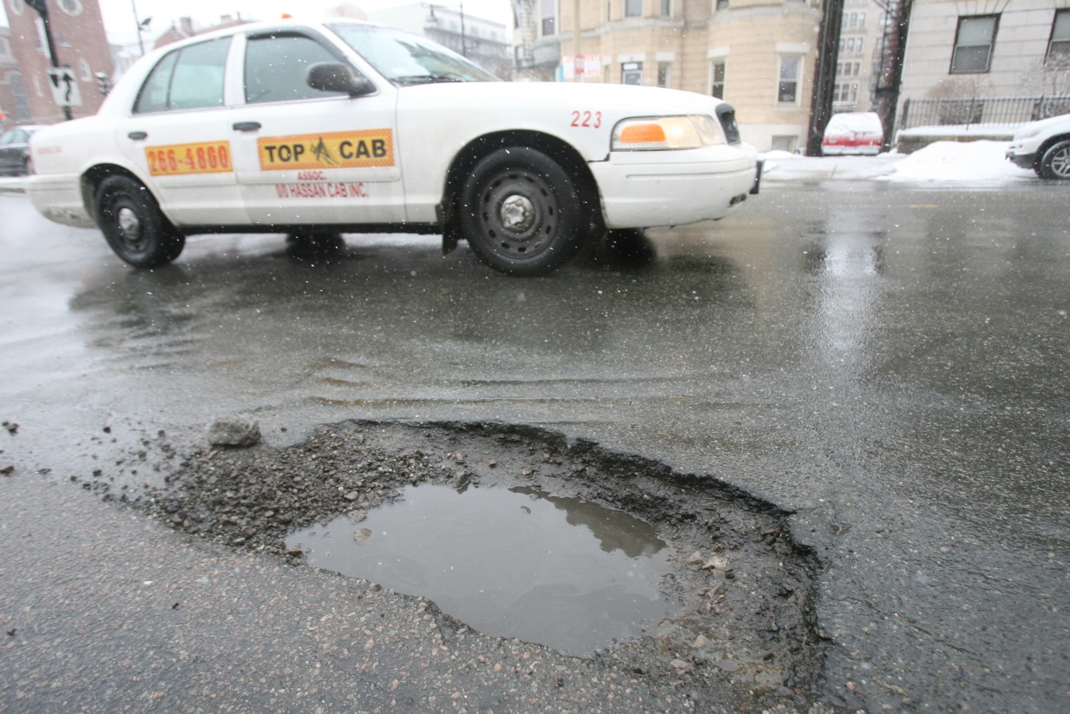
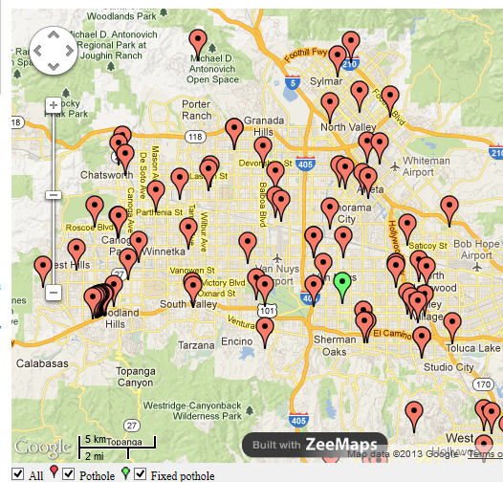
A More Complex Application
GPS-based Pothole Alarm and Moving Map
Sounds alarm when approaching a pothole
Display’s vehicle position on LCD
Also logs driver’s position information
Hardware: GPS, user switches, speaker, LCD, flash memory

Slide 12
Application Software Tasks
Dec: Decode GPS sentence to find current vehicle position.
Check: Check to see if approaching any pothole locations. Takes longer as the number of potholes in database increases.
Rec: Record position to flash memory. Takes a long time if erasing a block.
Sw: Read user input switches. Run 10 times per second
LCD: Update LCD with map. Run 4 times per second
Dec
Check
Rec
Sw
LCD
Time

Slide 13
How do we schedule these tasks?
Task scheduling: Deciding which task should be running now
Two fundamental questions
Do we run tasks in the same order every time?
Yes: Static schedule (cyclic executive, round-robin)
No: Dynamic, prioritized schedule
Can one task preempt another, or must it wait for completion?
Yes: Preemptive
No: Non-preemptive (cooperative, run-to-completion)
Dec
Check
Rec
Sw
LCD

Slide 14
Static Schedule (Cyclic Executive)
Dec
Check
Rec
Sw
LCD
Dec
Pros
Very simple
Cons
Always run the same schedule, regardless of changing conditions and relative importance of tasks.
All tasks run at same rate. Changing rates requires adding extra calls to the function.
Maximum delay is sum of all task run times. Polling/execution rate is 1/maximum delay.
while (1){
Dec();
Check();
Rec();
Sw();
LCD();
}

Slide 15
Static Schedule Example
GPS Data Arrives
Checking complete
Response Time
Rec
Sw
LCD
Dec
Check
What if we receive GPS position right after Rec starts running?
Delays
Have to wait for Rec, Sw, LCD before we start decoding position with Dec.
Have to wait for Rec, Sw, LCD, Dec, Check before we know if we are approaching a pothole!

Slide 16
Dynamic Scheduling
Allow schedule to be computed on-the-fly
Based on importance or something else
Simplifies creating multi-rate systems
Schedule based on importance
Prioritization means that less important tasks don’t delay more important ones
How often do we decide what to run?
Coarse grain – After a task finishes. Called Run-to-Completion (RTC) or non-preemptive
Fine grain – Any time. Called Preemptive, since one task can preempt another.

Slide 17
Dynamic RTC Schedule
GPS Data Arrives
Checking complete
Response Time
Rec
Dec
Check
What if we receive GPS position right after Rec starts running?
Delays
Have to wait for Rec to finish before we start decoding position with Dec.
Have to wait for Rec, Dec, Check before we know if we are approaching a pothole

Slide 18
Task State and Scheduling Rules
Scheduler chooses among Ready tasks for execution based on priority
Scheduling Rules
If no task is running, scheduler starts the highest priority ready task
Once started, a task runs until it completes
Tasks then enter waiting state until triggered or released again
Ready
Task is released (ready to run)
Start highest
priority
ready task
Waiting
Running
Task completes

Slide 19
Dynamic Preemptive Schedule
GPS Data Arrives
Checking complete
Response Time
Dec
Check
Rec
What if we receive GPS position right after Rec starts running?
Delays
Scheduler switches out Rec so we can start decoding position with Dec immediately
Have to wait for Dec, Check to complete before we know if we are approaching a pothole

Slide 20
Comparison of Response Times
Static
Rec
Sw
LCD
Dec
Check
Dynamic Run-to-Completion
Rec
Dec
Check
Dynamic Preemptive
Dec
Check
Pros
Preemption offers best response time
Can do more processing (support more potholes, or higher vehicle speed)
Or can lower processor speed, saving money, power
Cons
Requires more complicated programming, more memory
Introduces vulnerability to data race conditions

Slide 21
Common Schedulers
Cyclic executive - non-preemptive and static
Run-to-completion - non-preemptive and dynamic
Preemptive and dynamic

Slide 22
Round-Robin with Interrupts
BOOL DeviceARequest, DeviceBRequest, DeviceCRequest;
void interrupt HandleDeviceA(){
/* do A’s urgent work */
...
DeviceARequest = TRUE;
}
void main(void) {
while (TRUE) {
if (DeviceARequest) {
FinishDeviceA();
}
if (DeviceBRequest) {
FinishDeviceB();
}
if (DeviceCRequest) {
FinishDeviceC();
}
}
}
Two priority levels
main code – foreground
Interrupts – background
Example of a foreground / background system
Main user code runs in foreground
Interrupt routines run in background (high priority)
Run when triggered
Handle most urgent work
Set flags to request processing by main loop

Slide 23
Run-To-Completion Scheduler
Use a scheduler function to run task functions at the right rates
Table stores information per task
Period: How many ticks between each task release
Release Time: how long until task is ready to run
ReadyToRun: task is ready to run immediately
Scheduler runs forever, examining schedule table which indicates tasks which are ready to run (have been “released”)
A periodic timer interrupt triggers an ISR, which updates the schedule table
Decrements “time until next release”
If this time reaches 0, set that task’s Run flag and reload its time with the period
Follows a “run-to-completion” model
A task’s execution is not interleaved with any other task
Only ISRs can interrupt a task
After ISR completes, the previously-running task resumes
Priority is typically static, so can use a table with highest priority tasks first for a fast, simple scheduler implementation.

Slide 24
Preemptive Scheduler
Task functions need not run to completion, but can be interleaved with each other
Simplifies writing software
Improves response time
Introduces new potential problems
Worst case response time for highest priority task does not depend on other tasks, only ISRs and scheduler
Lower priority tasks depend only on higher priority tasks

Slide 25
Task State and Scheduling Rules
Scheduler chooses among Ready tasks for execution based on priority
Scheduling Rules
A task’s activities may lead it to waiting (blocked)
A waiting task never gets the CPU. It must be signaled by an ISR or another task.
Only the scheduler moves tasks between ready and running
Ready
What the
task needs
happens
This is
highest
priority
ready task
This isn’t
highest
priority
ready task
Waiting
Task needs
something
to happen
Running

Slide 26
What’s an RTOS?
What does Real-Time mean?
Can calculate and guarantee the maximum response time for each task and interrupt service routine
This “bounding” of response times allows use in hard-real-time systems (which have deadlines which must be met)
What’s in the RTOS
Task Scheduler
Preemptive, prioritized to minimize response times
Interrupt support
Core Integrated RTOS services
Inter-process communication and synchronization (safe data sharing)
Time management
Optional Integrated RTOS services
I/O abstractions?
memory management?
file system?
networking support?
GUI??

Slide 27
Comparison of Timing Dependence
Non-preemptive Static
Non-preemptive Dynamic
Preemptive Dynamic
Device A ISR
Device A ISR
Device A ISR
Device B ISR
Device B ISR
Device B ISR
Device ... ISR
Device ... ISR
Device ... ISR
Device Z ISR
Device Z ISR
Device Z ISR
Slowest Task
Task 5 Code
Task 1 Code
Task 1 Code
Task 1 Code
Task 2 Code
Task 4 Code
Task 3 Code
Task 6 Code
Task 2 Code
Task 2 Code
Task 3 Code
Task 3 Code
Code can be delayed by everything at same level (in oval) or above
Task 4 Code
Task 4 Code
Task 5 Code
Task 5 Code
Task 6 Code
Task 6 Code

Slide 28
Comparison of RAM Requirements
Task 4 Max Stack
Task 3 Max Stack
Non-preemptive Static
Non-preemptive Dynamic
Preemptive Dynamic
Task 2 Max Stack
Task 2 Max Stack
Task 2 Max Stack
Task 1 Max Stack
Task 4 Max Stack
Task 1 Max Stack
Task 4 Max Stack
Task 3 Max Stack
Task 3 Max Stack
Task 1 Max Stack
Task 1 Statics
Task 2 Statics
Task 3 Statics
Task 4 Statics
Task 1 Statics
Task 2 Statics
Task 3 Statics
Task 4 Statics
Task 1 Statics
Task 2 Statics
Task 3 Statics
Task 4 Statics
Preemption requires space for each stack*
Need space for all static variables (including globals)
*except for certain special cases

Slide 29
Software Engineering FOR Embedded Systems

Slide 30
Good Enough Software, Soon Enough
How do we make software correct enough without going bankrupt?
Need to be able to develop (and test) software efficiently
Follow a good plan
Start with customer requirements
Design architectures to define the building blocks of the systems (tasks, modules, etc.)
Add missing requirements
Fault detection, management and logging
Real-time issues
Compliance to a firmware standards manual
Fail-safes
Create detailed design
Implement the code, following a good development process
Perform frequent design and code reviews
Perform frequent testing (unit and system testing, preferably automated)
Use revision control to manage changes
Perform post-mortems to improve development process

Slide 31
What happens when the plan meets reality?
We want a robust plan which considers likely risks
What if the code turns out to be a lot more complex than we expected?
What if there is a bug in our code (or a library)?
What if the system doesn’t have enough memory or throughput?
What if the system is too expensive?
What if the lead developer quits?
What if the lead developer is incompetent, lazy, or both (and won’t quit!)?
What if the rest of the team gets sick?
What if the customer adds new requirements?
What if the customer wants the product two months early?
Successful software engineering depends on balancing many factors, many of which are non-technical!

Slide 32
Risk Reduction
Plan to the work to accommodate risks
Identify likely risks up front
Historical problem areas
New implementation technologies
New product features
New product line
Severity of risk is combination of likelihood and impact of failure

Slide 33
Software Lifecycle Concepts
Coding is the most visible part of a software development process but is not the only one
Before we can code, we must know
What must the code do? Requirements specification
How will the code be structured? Design specification
(only at this point can we start writing code)
How will we know if the code works? Test plan
Best performed when defining requirements
The software will likely be enhanced over time - Extensive downstream modification and maintenance!
Corrections, adaptations, enhancements & preventive maintenance

Slide 34
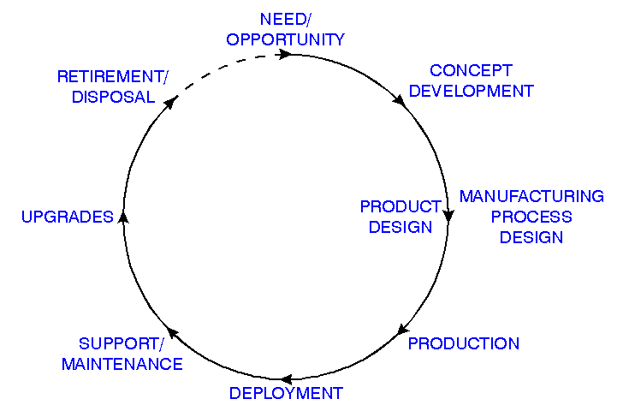
Product Development Lifecycle
Coding
Coding
Coding
Coding
Diagram: Phil Koopman, Carnegie Mellon University
Coding
Coding
With all this code development and modification, it is worth putting extra effort into simplifying code development activities: understanding, maintaining, enhancing, testing

Slide 35
Requirements
Ganssle’s Reason #5 for why embedded projects fail: Vague Requirements
Types of requirements
Functional - what the system needs to do
Nonfunctional - emergent system behaviors such as response time, reliability, energy efficiency, safety, etc.
Constraints - limit design choices
Representations
Text – Liable to be incomplete, bloated, ambiguous, even contradictory
Diagrams (state charts, flow charts, message sequence charts)
Concise
Can often be used as design documents
Traceability
Each requirement should be verifiable with a test
Stability
Requirements churn leads to inefficiency and often “recency” problem (most recent requirement change is assumed to be most important)

Slide 36
Design Before Coding
Architectural Design
Detailed Design
Coding
Test the Code
Ganssle’s reason #9: Starting coding too soon
Underestimating the complexity of the needed software is a very common risk
Writing code locks you in to specific implementations
Starting too early may paint you into a corner
Benefits of designing system before coding
Get early insight into system’s complexity, allowing more accurate effort estimation and scheduling
Can use design diagrams rather than code to discuss what system should do and how. Ganssle’s reason #7: Bad Science
Can use design diagrams in documentation to simplify code maintenance and reduce risks of staff turnover

Slide 37
Design Before Coding
How much of the system do you design before coding?
AD
DD
C
T
AD
DD
C
T
AD
DD
C
T
AD
DD
C
T
AD
DD
C
T
AD
DD
C
T
AD
Prototyping
DD
C
T
AD
DD
C
T
AD
DD
C
T

Slide 38
Development Models
How do we schedule these pieces?
Consider amount of development risk
New MCU?
Exceptional requirements (throughput, power, safety certification, etc.)
New product?
New customer?
Changing requirements?
Choose model based on risk
Low: Can create detailed plan. Big-up-front design, waterfall
High: Use iterative or agile development method, spiral. Prototype high-risk parts first

Slide 39
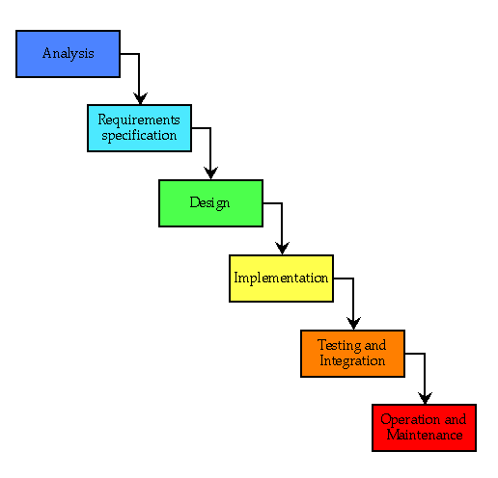
Waterfall (Idealized)
Plan the work, and then work the plan
BUFD: Big Up-Front Design
Model implies that we and the customers know
All of the requirements up front
All of the interactions between components, etc.
How long it will take to write the software and debug it
Diagram: Jon McCormack, Monash University

Slide 40
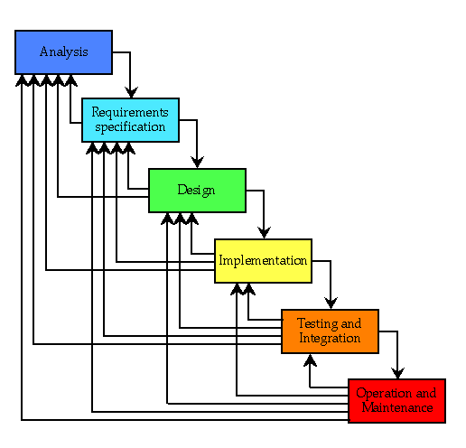
Waterfall (As Implemented)
Reality: We are not omniscient, so there is plenty of backtracking
Diagram: Jon McCormack, Monash University

Slide 41
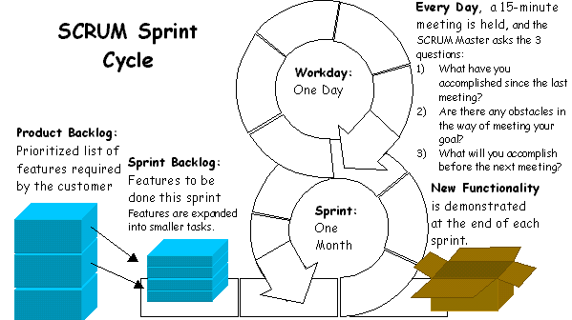
Agile Development: SCRUM
http://www.mountaingoatsoftware.com/topics/scrum
http://www.codeproject.com/KB/architecture/scrum.aspx
Diagram: Wikipedia

Slide 42
V Model Overview
Requirements Analysis
Requirements Specification
Validation provided by testing
Functional
Testing
Review
Architectural
Design
Integration
Testing
Review
Detailed
Design
Integration
Testing
Review
Coding
S/W Unit
Testing
Review
Code
Themes:
Link front and back ends of life-cycle for efficiency
Provide “traceability” to ensure nothing falls through the cracks
Notes:
"Validation. The assurance that a product, service, or system meets the needs of the customer and other identified stakeholders. It often involves acceptance and suitability with external customers. Contrast with verification.“
"Verification. The evaluation of whether or not a product, service, or system complies with a regulation, requirement, specification, or imposed condition. It is often an internal process. Contrast with validation.“

Slide 43
1. Requirements Specification and Validation Plan
Result of Requirements Analysis
Should contain:
Introduction with goals and objectives of system
Description of problem to solve
Functional description
provides a “processing narrative” per function
lists and justifies design constraints
explains performance requirements
Behavioral description shows how system reacts to internal or external events and situations
State-based behavior
General control flow
General data flow
Validation criteria
tell us how we can decide that a system is acceptable. (Are we done yet?)
is the foundation for a validation test plan
Bibliography and Appendix refer to all documents related to project and provide supplementary information

Slide 44
2. Architectural (High-Level) Design
Architecture defines the structure of the system
Components
Externally visible properties of components
Relationships among components
Architecture is a representation which lets the designer…
Analyze the design’s effectiveness in meeting requirements
Consider alternative architectures early
Reduce down-stream implementation risks
Architecture matters because…
It’s small and simple enough to fit into a single person’s brain (as opposed to comprehending the entire program’s source code)
It gives stakeholders a way to describe and therefore discuss the system

Slide 45
3. Detailed Design
Describe aspects of how system behaves
Flow charts for control or data
State machine diagram
Event sequences
Graphical representations very helpful
Can provide clear, single-page visualization of what system component should do
Unified Modeling Language (UML)
Provides many types of diagrams
Some are useful for embedded system design to describe structure or behavior

Slide 46
State Machine for Parsing NMEA-0183
Start
Any char. except *, \r or \n
Append char to buf. Inc. counter
$ Append char to buf.
Talker + Sentence Type
*, \r or \n, non-text, or counter>6
buf==$SDDBT, $VWVHW, or $YXXDR
Enqueue all chars. from buf
/r or /n
Sentence Body
Any char. except *
Enqueue char
*
Enqueue char
Checksum 1
Any char.
Save as checksum1
Checksum 2
Any char.
Save as checksum2
Notes:
Page 150 “Conrad-Dean”, slide 19 of UNC Software Testing,

Slide 47
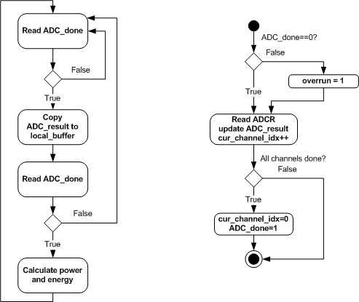
Flowcharts

Slide 48
Sequence of Interactions between Components

Slide 49
4. Coding and Code Inspections
Coding driven directly by Detailed Design Specification
Use a version control system while developing the code
Follow a coding standard
Eliminate stylistic variations which make understanding code more difficult
Avoid known questionable practices
Spell out best practices to make them easier to follow
Perform code reviews
Test effectively
Automation
Regression testing

Slide 50
Peer Code Review
Inspect the code before testing it
Extensive positive industry results from code inspections
IBM removed 82% of bugs
9 hours saved by finding each defect
For AT&T quality rose by 1000% and productivity by 14%
Finds bugs which testing often misses
80% of the errors detected by HP’s inspections were unlikely to be caught by testing
HP, Shell Research, Bell Northern, AT&T: inspections 20-30x more efficient than testing

Slide 51
5. Software Testing
Testing IS NOT “the process of verifying the program works correctly”
The program probably won’t work correctly in all possible cases
Professional programmers have 1-3 bugs per 100 lines of code after it is “done”
Testers shouldn’t try to prove the program works correctly (impossible)
If you want and expect your program to work, you’ll unconsciously miss failure because human beings are inherently biased
The purpose of testing is to find problems quickly
Does the software violate the specifications?
Does the software violate unstated requirements?
The purpose of finding problems is to fix the ones which matter
Fix the most important problems, as there isn’t enough time to fix all of them
The Pareto Principle defines “the vital few, the trivial many”
Bugs are uneven in frequency – a vital few contribute the majority of the program failures. Fix these first.

Slide 52
Approaches to Testing
Incremental Testing
Code a function and then test it (module/unit/element testing)
Then test a few working functions together (integration testing)
Continue enlarging the scope of tests as you write new functions
Incremental testing requires extra code for the test harness
A driver function calls the function to be tested
A stub function might be needed to simulate a function called by the function under test, and which returns or modifies data.
The test harness can automate the testing of individual functions to detect later bugs
Big Bang Testing
Code up all of the functions to create the system
Test the complete system
Plug and pray

Slide 53
Why Test Incrementally?
Finding out what failed is much easier
With Big Bang, since no function has been thoroughly tested, most probably have bugs
Now the question is “Which bug in which module causes the failure I see?”
Errors in one module can make it difficult to test another module
Errors in fundamental modules (e.g. kernel) can appear as bugs in other many other dependent modules
Less finger pointing = happier SW development team
It’s clear who made the mistake, and it’s clear who needs to fix it
Better automation
Drivers and stubs initially require time to develop, but save time for future testing

Slide 54
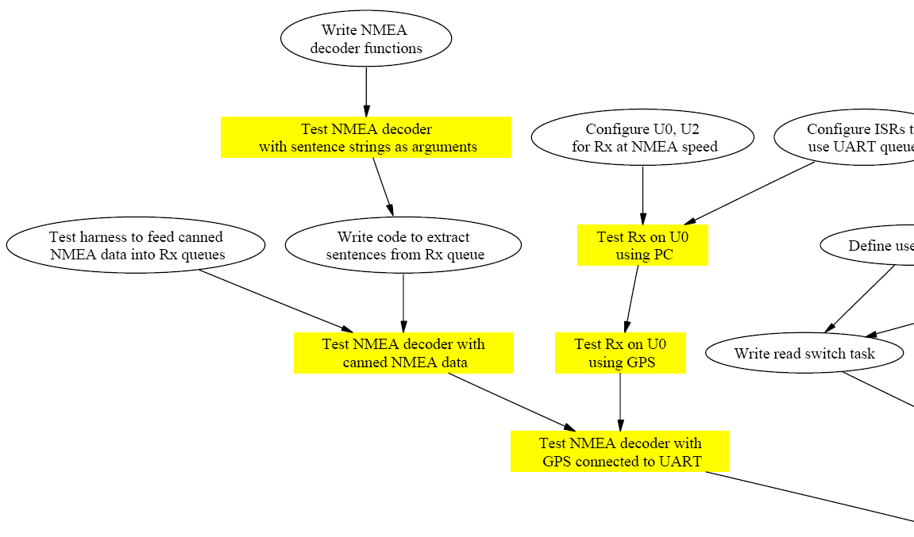
Example Test Plan

Slide 55
6. Perform Project Retrospectives
Goals – improve your engineering processes
Extract all useful information learned from the just-completed project – provide “virtual experience” to others
Provide positive non-confrontational feedback
Document problems and solutions clearly and concisely for future use
Basic rule: problems need solutions
Often small changes improve performance, but are easy to forget

Slide 56
Example Postmortem Structure
Product
Bugs
Software design
Hardware design
Process
Code standards
Code interfacing
Change control
How we did it
Team coordination
Support
Tools
Team burnout
Change orders
Personnel availability

Slide 57
#include "mbed.h"
InterruptIn button(SW2);
DigitalOut led(LED1);
DigitalOut flash(LED4);
void flip() {
led = !led; }
int main() {
button.rise(&flip); // attach the address of the // flip function to the rising edge
while(1) { // wait around, interrupts will interrupt this! flash = !flash;
wait(0.25); }
}

